Slide 1

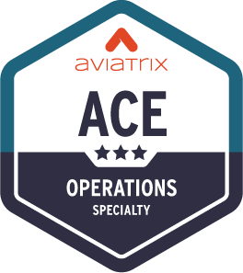
ACE Operations
Day - 1
ACE Solutions Architecture Team

Slide 2




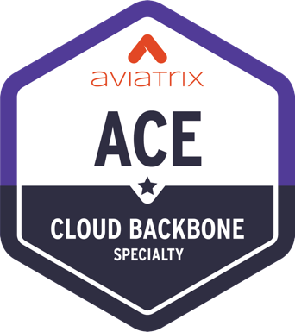


ACE Multicloud Networking Learning Paths
https://aviatrix.com/ace/
The industry’s first and only multicloud networking certification
Standard Learning Path
6 Hours
Learn CSP networking basics and review Aviatrix features
3 Days
Deploy proven design patterns for a multicloud network architecture
Weeks
Design a highly available, scalable, and secure multicloud architecture
Optional Specialty Trainings
4 Hours
Use IaC tools to build, enhance, and secure infrastructure
4 Hours
Use the Aviatrix backbone to build hybrid connections
16 Hours
Troubleshoot real-world Day 2 cloud issues​
4 Hours
How to secure the network deployed inside the cloud

Slide 3





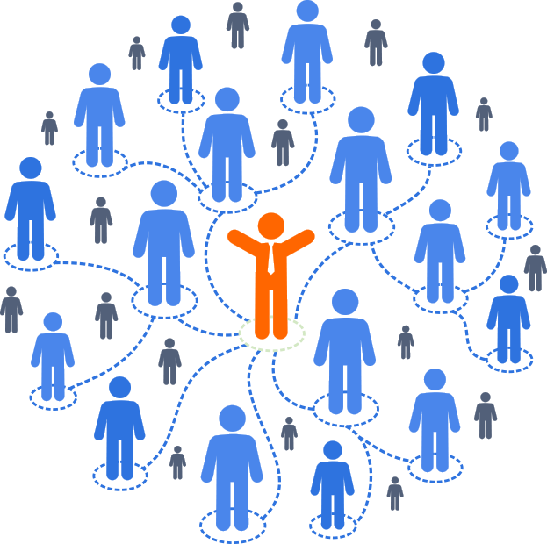
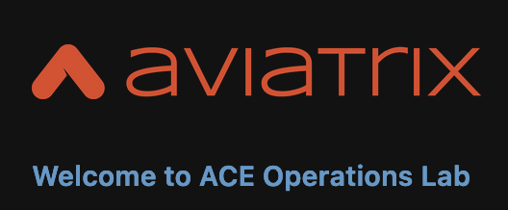
Join the ACE Community
POD & Lab Guides
Join hands with fellow Network Engineers, help lead transformation in your orgs, and grow your careers
Personal POD access details and 8x walkthrough Labs
https://community.aviatrix.com
https://docs.aviatrixlab.com/ace-ops/docs/home.html

Slide 4
Prerequisite, Expectations & How to get Certified
Prerequisite:
ACE Associate. ACE Professional is highly recommended.
Expectations:
The focus is on gaining familiarity with tools at your disposal for troubleshooting real-world Day 2 cloud issues. This is NOT a Build/Design training (please refer to the ACE PRO training).
How to get Certified:
Create Aviatrix ACE Academy Account: https://ace.aviatrix.com
A Subset of Aviatrix use cases will be discussed (these are meaningful use cases collected from real scenarios)
There are 8 Labs that you will have to complete (an automated script will evaluate the completion of all labs). PODs will be torn down as soon as the training has been completed.
Attend the entire course.
On day 2, you will work with other participants on another dedicated pod (i.e., “Let’s troubleshoot together” POD), where you will be presented with several failures. The objective is to identify and fix the failures using the Aviatrix platform tools.
Demonstrate a collaborative approach (it is NOT mandatory to resolve all failures ☺).
Complete the Survey.

Slide 5
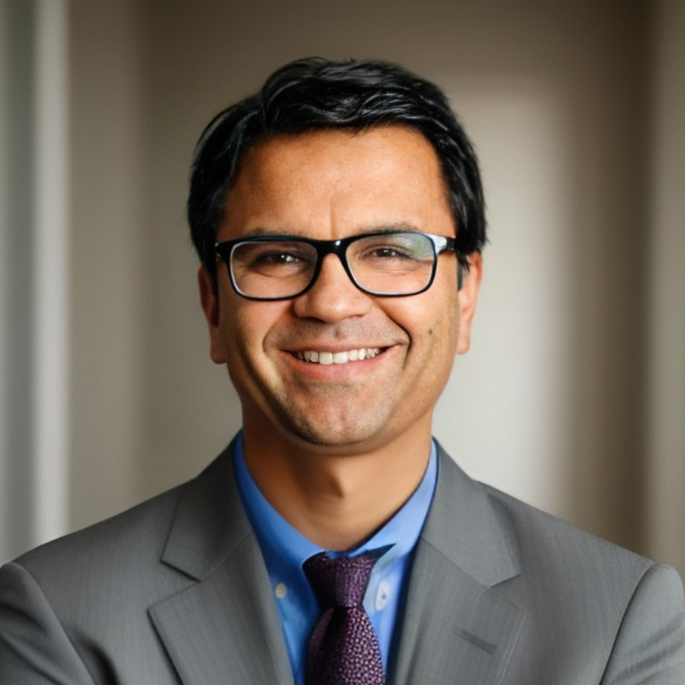
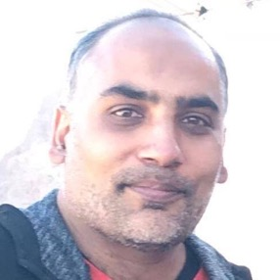
Aviatrix Certified Engineer – Operations Day 1
Day-1 Morning | Approx. Duration | Start time EDT
Welcome / Logistics / Agenda / Intro | 0:10 | 10:00 AM
Walkthrough of Operational features of platform | 0:50 | 10:10 AM
Network Segmentation | 0:15 | 11:00 AM
Lab 1 Network Domains | 0:30 | 11:15 AM
Lab 1 Resolution | 0:05 | 11:45 AM
Break | 0:20 | 11:50 AM
Lab 2 Connection Policy | 0:20 | 12:10 AM
Lab 2 Resolution | 0:05 | 12:30 AM
FireNet | 0:40 | 12:35 AM
Lab 3 FireNet - Interface | 0:30 | 1:15 PM
Lab 3 Resolution | 0:15 | 1:45 PM
Lunch Break | 1:00 | 2:00 PM
Meet the Presenters
Shahzad Ali
VP, Solutions Architecture
https://youtube.com/netJoints
Rizwan Jamal
Senior Solutions Architect,
Aviatrix
Past: Equinix, Microsoft, Cisco
linkedin.com/in/rizwan-j-35429723/

Slide 6
Aviatrix Certified Engineer – Operations Day 1
Meet the Trainers
Day-1 Afternoon | Approx. Duration | Start time EDT
Lab 4 FireNet - Routes | 0:30 | 3:00 PM
Lab 4 Resolution | 0:15 | 3:30 PM
Routes Manipulation & NAT | 0:30 | 3:45 PM
Break | 0:20 | 4:15 PM
Lab 5 Routes Manipulation & NAT | 0:35 | 4:35 PM
Lab 5 Resolution | 0:15 | 5:10 PM
Site2Cloud | 0:35 | 5:25 PM
END |  | 6:00 PM
Meet the Presenters
Shahzad Ali
VP, Solutions Architecture
https://youtube.com/netJoints
Rizwan Jamal
Senior Solutions Architect,
Aviatrix
Past: Equinix, Microsoft, Cisco
linkedin.com/in/rizwan-j-35429723/

Slide 7
Aviatrix Certified Engineer – Cloud Operations Day 2
Meet the Trainers
Day-2 Morning | Approx. Duration | Start time EDT
Welcome / Agenda | 0:10 | 10:00 AM
Lab 6 Site2Cloud | 0:40 | 10:10 AM
Lab 6 Resolution | 0:20 | 10:50 AM
Egress FQDN | 0:20 | 11:10 AM
Break | 0:20 | 11:30 AM
Lab 7 Egress FQDN | 0:20 | 11:50 AM
Lab 7 Resolution | 0:10 | 12:10 AM
Operational Best Practices | 0:40 | 12:20 AM
Launch Break | 1:00 | 1:00 PM
Meet the Presenters
Shahzad Ali
VP, Solutions Architecture
https://youtube.com/netJoints
Rizwan Jamal
Senior Solutions Architect,
Aviatrix
Past: Equinix, Microsoft, Cisco
linkedin.com/in/rizwan-j-35429723/

Slide 8
Aviatrix Certified Engineer – Cloud Operations Day 2
Day-2 Afternoon | Approx. Duration | Start time EDT
Distributed Cloud Firewall | 0:40 | 2:00 PM
Lab 8 Distributed Cloud Firewall | 0:30 | 2:40 PM
Lab 8 Resolution | 0:15 | 3:10 PM
BREAK | 0:20 | 3:25 PM
Let’s Troubleshoot Together | 1:30 | 3:45 PM
Scenarion Learnings / Survey / Certification Process | 0:30 | 5:15 PM
END |  | 5:45 PM
Meet the Presenters
Shahzad Ali
VP, Solutions Architecture
https://youtube.com/netJoints
Rizwan Jamal
Senior Solutions Architect,
Aviatrix
Past: Equinix, Microsoft, Cisco
linkedin.com/in/rizwan-j-35429723/

Slide 9
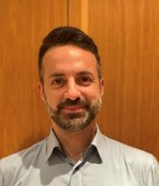
Aviatrix Certified Engineer – Operations Day 1
Day-1 Morning | Approx. Duration | Start time
Welcome / Logistics / Agenda / Intro | 0:10 | 9:00 AM
Walkthrough of Operational features of CoPilot | 0:50 | 9:10 AM
Network Segmentation | 0:15 | 10:00 AM
Lab 1 Network Segmentation | 0:30 | 10:15 AM
Lab 1 Resolution | 0:05 | 10:45 AM
Break | 0:20 | 10:50 AM
Lab 2 Connection Policy | 0:20 | 11:10 AM
Lab 2 Resolution | 0:05 | 11:30 AM
FireNet | 0:40 | 11:35 AM
Lab 3 FireNet - Interface | 0:30 | 12:15 AM
Lab 3 Resolution | 0:15 | 12:45 PM
Break | 1:00 | 1:00 PM
Meet the Presenter
Joe Amendolara
Senior Solutions Architect,
Aviatrix
Past: Whirlpool, Huawei, Orange
linkedin.com/in/joe-amendolara

Slide 10
Aviatrix Certified Engineer – Operations Day 1
Day-1 Afternoon | Approx. Duration | Start time
Lab 4 FireNet - Routes | 0:30 | 2:00 PM
Lab 4 Resolution | 0:15 | 2:30 PM
Routes Manipulation & NAT | 0:30 | 2:45 PM
Lab 5 Routes Manipulation & NAT | 0:35 | 3:15 PM
Lab 5 Resolution | 0:15 | 3:50 PM
Break | 0:20 | 4:05 PM
Site2Cloud | 0:35 | 4:25 PM
END |  | 5:00 PM
Meet the Presenter
Joe Amendolara
Senior Solutions Architect,
Aviatrix
Past: Whirlpool, Huawei, Orange
linkedin.com/in/joe-amendolara

Slide 11

Aviatrix Certified Engineer – Operations Day 1
Day-1 Afternoon | Approx. Duration | Start time EDT
Lab 4 FireNet - Routes | 0:30 | 3:00 PM
Lab 4 Resolution | 0:15 | 3:30 PM
Routes Manipulation & NAT | 0:30 | 3:45 PM
Break | 0:20 | 4:15 PM
Lab 5 Routes Manipulation & NAT | 0:35 | 4:35 PM
Lab 5 Resolution | 0:15 | 5:10 PM
Site2Cloud | 0:35 | 5:25 PM
END |  | 6:00 PM
Meet the Presenters
Joe Amendolara
Senior Solutions Architect,
Aviatrix
Past: Whirlpool, Huawei, Orange
linkedin.com/in/joe-amendolara
Rizwan Jamal
Senior Solutions Architect,
Aviatrix
Past: Equinix, Microsoft, Cisco
linkedin.com/in/rizwan-j-35429723/

Slide 12
Aviatrix Certified Engineer – Operations Day 2
Day-2 Morning | Approx. Duration | Start time
Welcome / Agenda | 0:10 | 9:00 AM
Lab 6 Site2Cloud | 0:35 | 9:10 AM
Lab 6 Resolution | 0:20 | 9:45 AM
Secure Egress | 0:20 | 10:05 AM
Break | 0:20 | 10:25 AM
Lab 7 Secure Egress | 0:40 | 10:45 AM
Lab 7 Resolution | 0:15 | 11:25 AM
Operational Best Practices | 0:45 | 11:40 AM
Distributed Cloud Firewall | 0:35 | 12:25 PM
Launch Break | 1:00 | 1:00 PM
Meet the Presenter
Joe Amendolara
Senior Solutions Architect,
Aviatrix
Past: Whirlpool, Huawei, Orange
linkedin.com/in/joe-amendolara

Slide 13
Aviatrix Certified Engineer – Operations Day 2
Day-2 Afternoon | Approx. Duration | Start time
Lab 8 Distributed Cloud Firewall | 0:35 | 2:00 PM
Lab 8 Resolution | 0:20 | 2:35 PM
Break | 0:10 | 2:55 PM
Let’s Troubleshoot Together | 1:30 | 3:05 PM
Scenario Learnings / Survey / Certification Process | 0:25 | 4:35 PM
END |  | 5:00 PM
Meet the Presenter
Joe Amendolara
Senior Solutions Architect,
Aviatrix
Past: Whirlpool, Huawei, Orange
linkedin.com/in/joe-amendolara

Slide 14
LAB TYPES: Validation Request / Change Request / Tshoot Request
Lab 1: Network Domains → Validation Request
Lab 2: Connection Policy → Change and Tshoot Request
Lab 3: FireNet – Interface → Tshoot Request
Lab 4: FireNet – Routes → Tshoot Request
Lab 5: Routes Manipulation & NAT → Tshoot Request
Lab 6: Site2Cloud → 2x Change Requests
Lab 7: Secure Egress→ Change Request
Lab 8: Distributed Cloud Firewall → Change Request

